Slide 1
Problem Statement :-Intelligent Crop Health Advisor with Disease Diagnosis and Text/Voice Chatbot Integration
1
2
3
4
Sairaj Magdum
Kedar Kolase
Dattaraj Jadhav
Anurag Mhaske
OBJECTIVES
IMPACT AND BENEFITS
IIdentifies Sugarcane Health: Classifies sugarcane leaves from images using a dedicated deep learning model.
Diagnoses Sugarcane Diseases: Detects and classifies sugarcane diseases (e.g., red rot, white leaf) for accurate health assessments.
Provides Actionable Advice: Employs a local Hugging Face LLM to deliver tailored crop care, treatment plans, and agricultural advice specifically for sugarcane farmers.
Interactive Chatbot: Integrates a multilingual text/voice chatbot to deliver diagnosis results and recommendations, enhancing accessibility for rural sugarcane growers.
Agricultural Productivity: Reduces crop losses through early disease detection, enhancing farm output.
Crop and Disease Identification: Separate DL models ensure precise crop and disease identification
User-Friendly Interface: Multilingual text/voice chatbot simplifies interaction.
Promotes Sustainability: Minimizes pesticide overuse via precise treatments
Accessibility: Provides multilingual text/voice chatbot support, making agricultural expertise accessible to non-technical and non-English-speaking farmers.

Slide 2
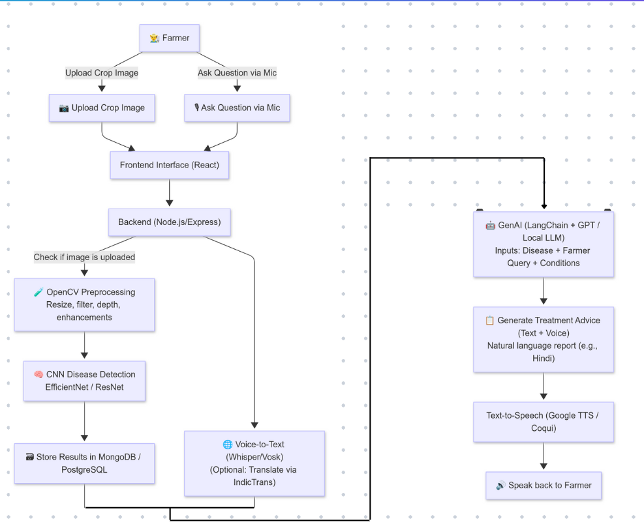
Explaining Problem statement : Intelligent Crop Health Advisor with Disease Diagnosis and Text/Voice Chatbot Integration
Architecture Diagram
1.Identifying Crops and Diseases:
Lack of expertise/tools to detect crop types
and diseases early.
2. Accessing Expert Advice:
Limited availability of tailored, affordable
agricultural guidance.
3. Multilingual Text/Voice Chatbot:
Supports user-friendly text and voice
interactions in multiple languages, enhancing
accessibility for rural and non-technical
farmers.
4. A fine-tuned local LLM for generating actionable advice.
5. Voice Chatbot Considerations:
Ensure STT/TTS models support local accents
and languages for accessibility.
This diagram shows the architecture and processing of the entire product and Amenities it provides

Slide 3
LITERATURE SURVEYS
Crop Identification: custom local crop datasets for training.
Disease Diagnosis: custom datasets (> 1000 images )for local diseases.
Chatbot: for dialogue; Common Voice for
multilingual STT/TTS training
Survey on Methodology
Survey on Datasets
Crop Identification: EfficiencyNet
Disease Diagnosis: EfficiencyNet
Recommendations: Ollama
Text/Voice Chatbot: Hugging Face pipeline with Whisper (STT) and VITS (TTS).
Text/Voice Chatbot:
Survey on Gaps
Survey on Results
Crop Identification: Limited dataset; use custom regional data, optimize EfficiencyNet
Disease Diagnosis: Lacks local diseases; collect custom data, balance classes.
LLM: Limited agricultural knowledge; fine-tune TinyLLaMA, add safety filters.Local language support.
Crop Identification: ≥80% accuracy, ≤1s inference time
Disease Diagnosis: ≥85% F1-score, high recall for early-stage diseases
LLM Recommendations: ≥80% user satisfaction, safe and relevant advice, ≤2s response time
Chatbot: ≥85% intent accuracy, WER

Slide 4
Conclusion
Tech Stack Overview
1. Deep Learning (Crop Disease Diagnosis)
Framework: TensorFlow
Model: EfficientNetB0-based CNN model
Data Processing: Pillow, OpenCV, NumPy
2. Local LLM Integration
Framework: Ollama
Models: Gemma 3 (local deployment)
Optimization: Quantization for efficient local inference
Tasks: Text generation & classification for disease advice
This project is a sugarcane disease detection system that uses a CNN model (EfficientNetB0-based) for image analysis and a local LLM (Gemma 3) for generating advice. Built with TensorFlow and Gradio, it offers a simple web interface for farmers to identify diseases and get management tips. The system runs offline, includes a knowledge base for reliable information, and provides responses in multiple languages.
Custom Dataset: Link
3. Web Interface
Framework: Gradio 3.41.2
Features: Real-time image upload, responsive design
4. Data Management
Structured Storage: JSON-based knowledge base
Data Processing: Python standard libraries

Slide 5
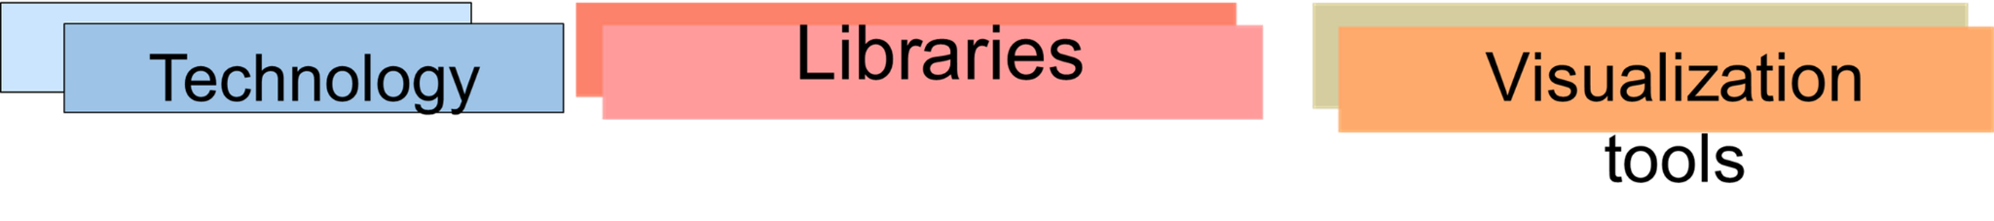
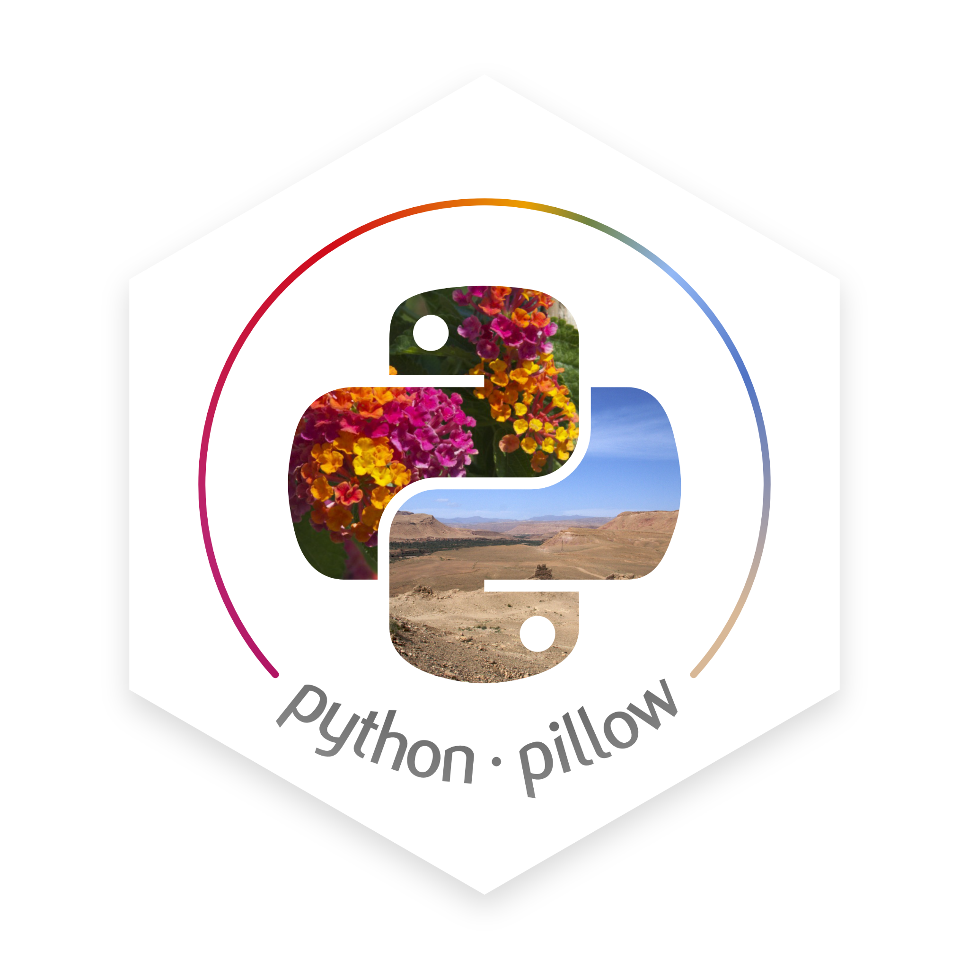


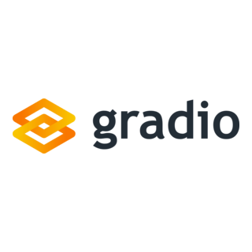



Slide 6
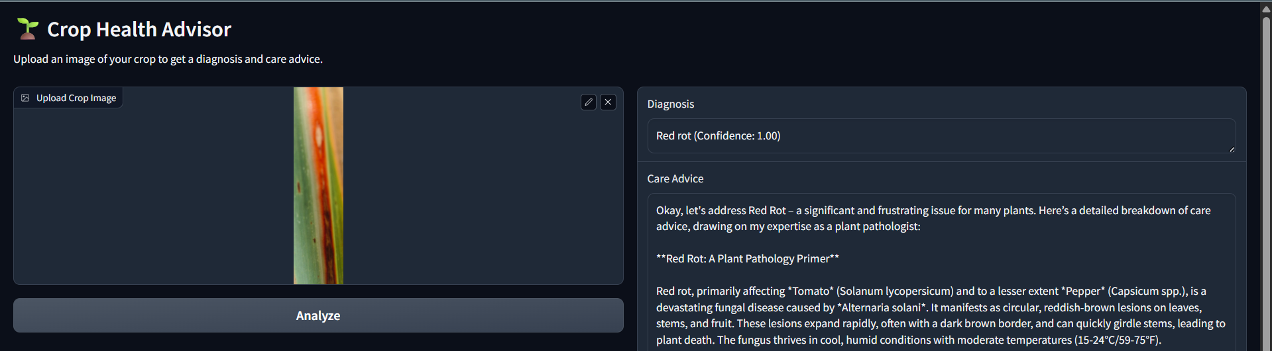
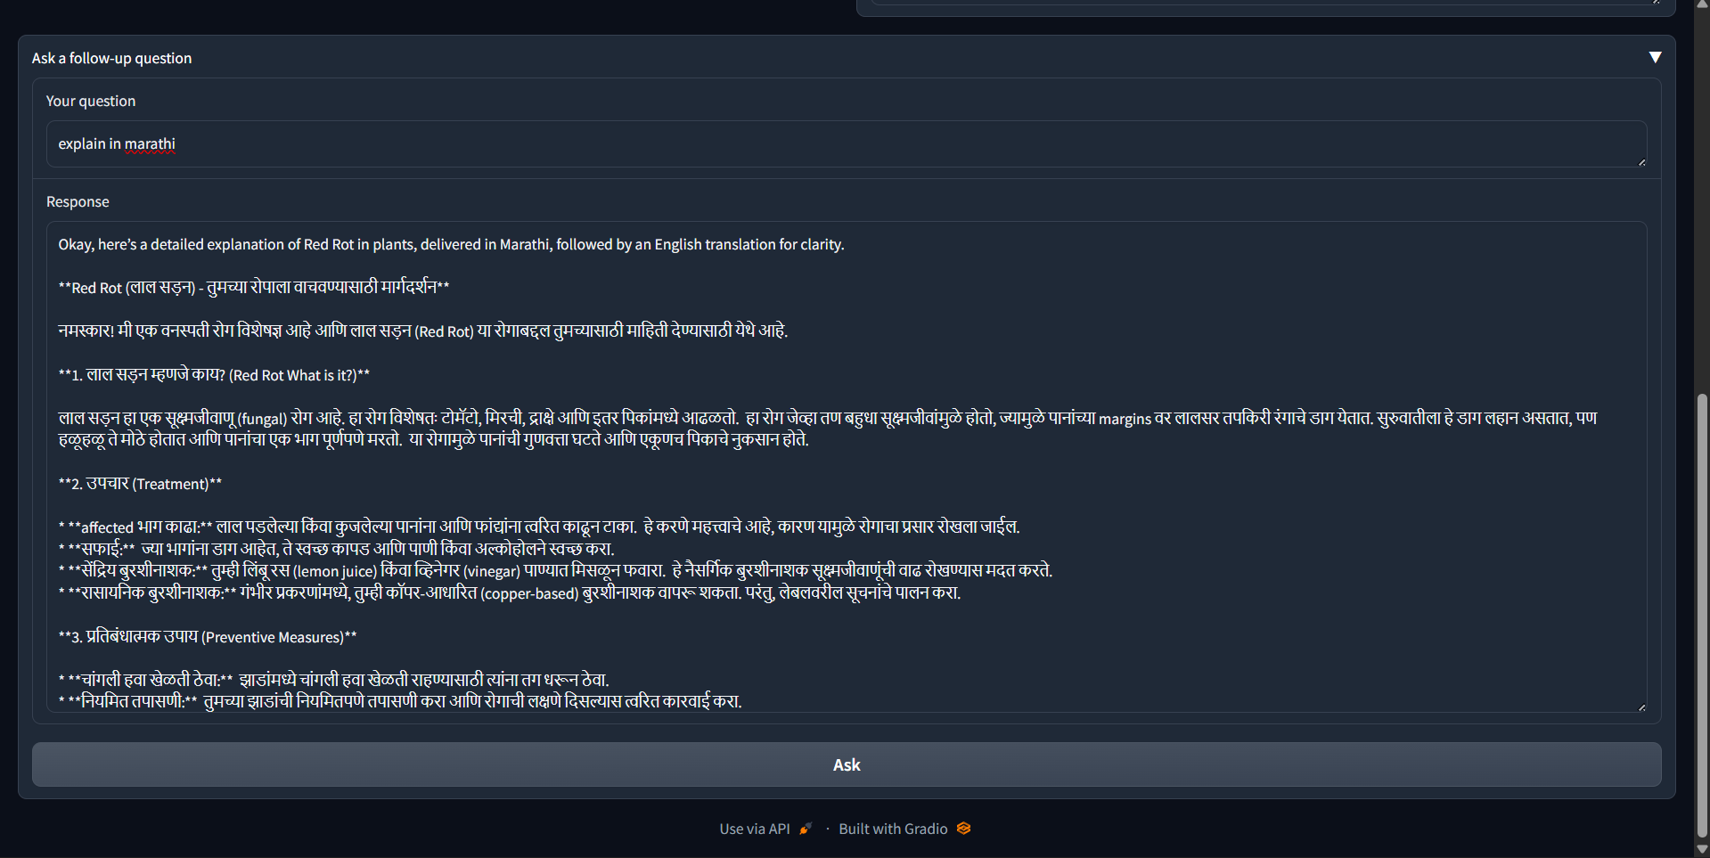
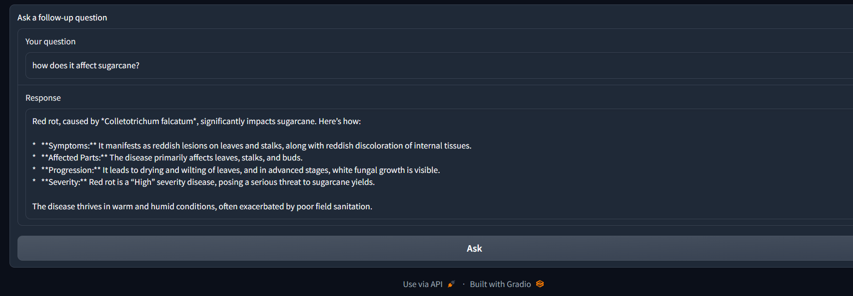
Output

Slide 7
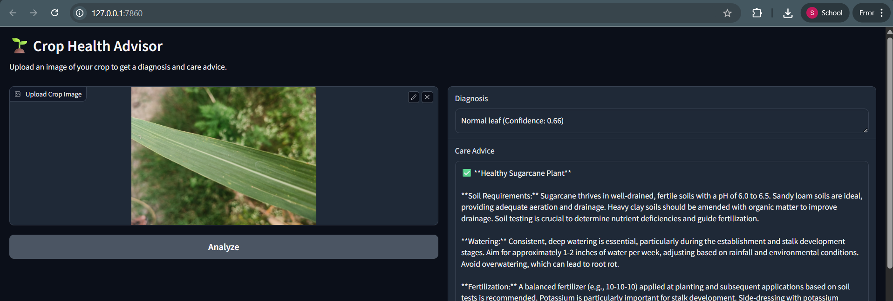
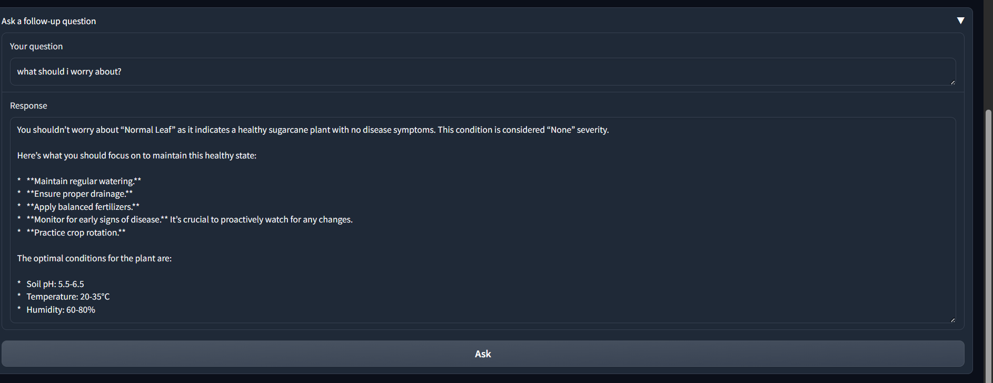

Slide 8
